Slide 1
Trailer Slick Plate

Slide 2
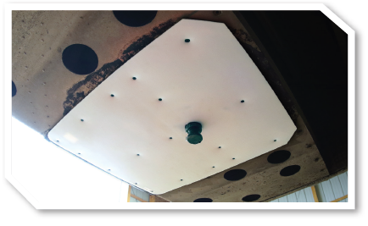

Slide 3
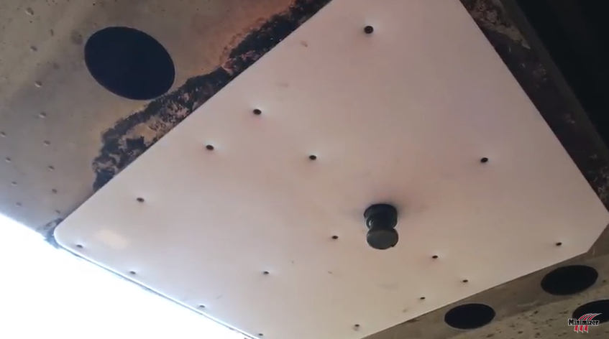
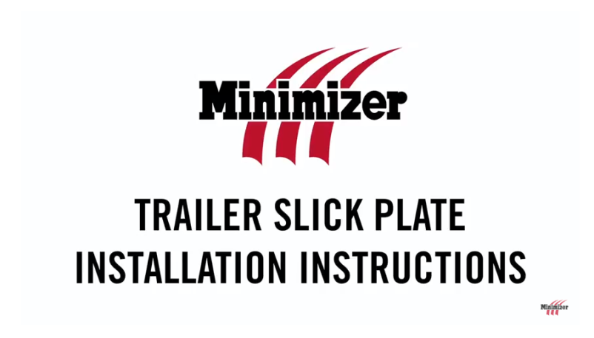
Slick Plate
Product Overview:
Installation:

Slide 4
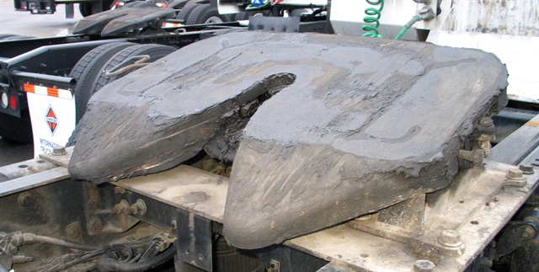
“People think it’s going to be there forever, and they don’t understand with this chloride and the use of grease on the fifth wheel, is that the road dirt gets into the grease and it mixes itself and kind of turns into a compound, like a rubbing compound, and it gets between the coupler and the plate and it actually wears these items down.” “You never see anybody putting grease on an upper coupler.”

Slide 5
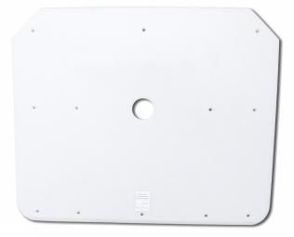
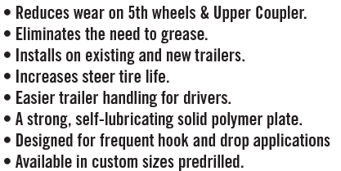
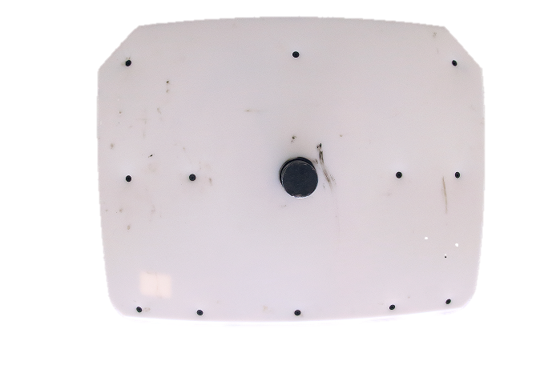

Slide 6
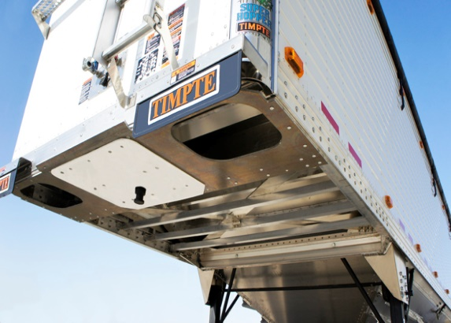
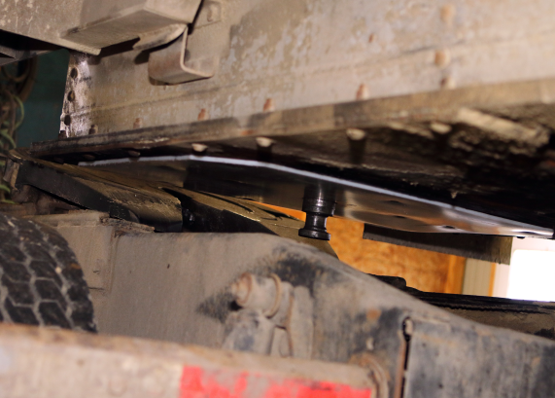
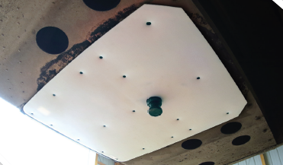
Fits Trailer OEM Make & Model
Fits most make and model OEM trailers
Warranty
5 Year Wear & Tear warranty
Features
Eliminates the need to grease 5th wheels
Eliminates the need to grease the upper coupler plate
Installs on existing and new trailers.
Easier trailer handling for drivers.
A strong, self-lubricating solid polymer plate.
Designed for frequent hook and drop applications.
Available in (9) sizes; predrilled, complete with counter sunk screws
Limit down time – no need to un-hook to grease plate again.
Increases steer tire life.
Extend the life of your 5th wheel plate
5 year warranty
Helps keep your upper coupler plate protected from the elements. Keeps the metal to metal wear off.

Slide 7
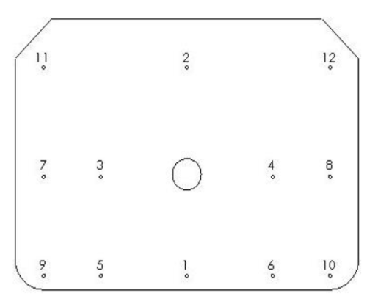
102340
102346
Dimensions
King Pin Setback
Minimizer Part#
Installation

Slide 8
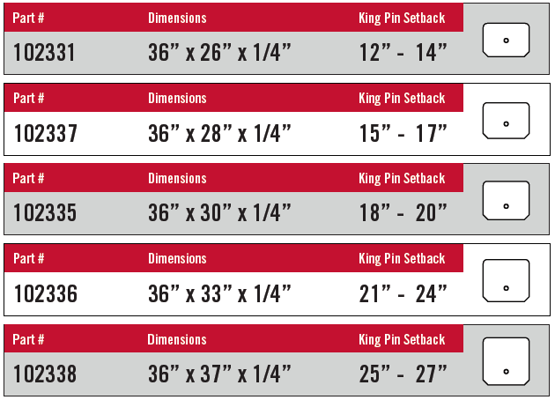
102340
102346
102344
102345
102347

Slide 9
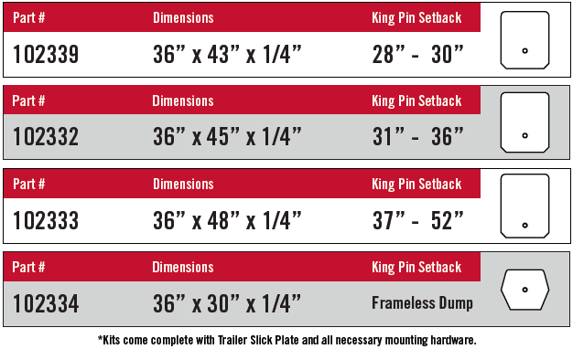
Slick Plate
102348
102341
102342
102343

Slide 10
Slick Plate

Slide 11
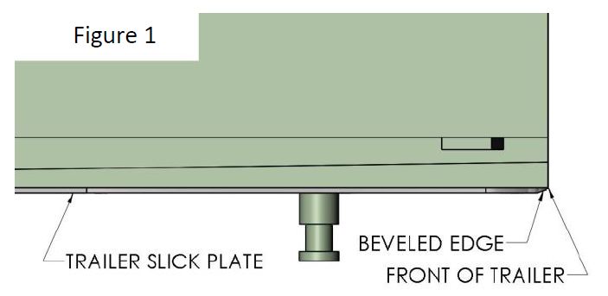
“TRAILER SLICK PLATE”
(INSTALLATION INSTRUCTIONS)
Place TRAILER SLICK PLATE on the trailer upper coupler plate with beveled edge placed toward the front of trailer. Ensure TRAILER SLICK PLATE is pushed up flat against trailer during installation and is flush to the front of the trailer to 2” short of the front of the trailer. See Figure
WARNING: If TRAILER SLICK PLATE extends beyond front of trailer or Upper Plate, DO NOT INSTALL.

Slide 12
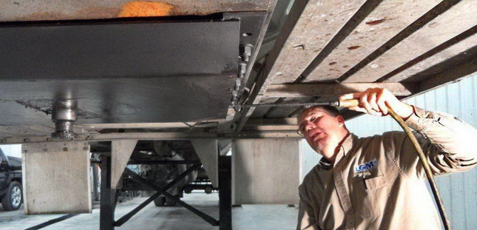
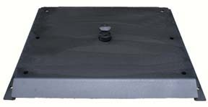
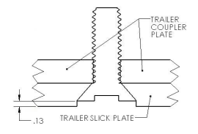
Degrease 5th Wheel and Upper Coupler Plate with solvent, or steam clean to remove grease.
Apply a rust inhibitor to keep Upper Plate from corroding. Rustoleum primer and paint will do a good job in preventing corrosion.
WARNING: Avoid getting water behind Plate when steam cleaning.
WARNING: BE SURE ALL BURRS ARE REMOVED FROM 5TH WHEEL.
**Follow the supplied Minimizer Trailer Slick Plate mounting instructions for complete install. Please contact us at 800-248-3855 for a detailed copy of our installation instructions.**

Slide 13
Minimizer Trailer Slick Plate: Care Instructions
DO NOT GREASE THE FIFTH WHEEL; for best performance and longevity it is recommended to keep the Poly Cover clean and dry.
Make sure the 5th wheel is not equipped with a “slick plate”. The use of both systems may result in failed jaw engagement with the king pin resulting in system failure.
Remove grease from the contact surface of the 5th wheel prior to hooking up.
Always be sure 5th Wheels are deburred before pinning up to TRAILER SLICK PLATE.
Periodically check bolts/nuts and retighten if necessary.
Continue to follow fifth wheel manufacturer’s lubrication and maintenance recommendations for the locking mechanism and king pin.
Apply a anti-rust inhibitor to the 5th Wheel during regular PM’s or every two months. This is only recommended to protect from corrosion. This will not affect the self-lubricating properties of Minimizer Trailer Slick Plate.

